Slide 1

DeepNeuron Training
Introduction to Deep Learning With FastAI

Slide 2
Training Structure
Workshop 1: Introduction to Deep Learning and FastAI - Ryan Hartshorne
Workshop 2: Introduction to PyTorch - Kamron Bhavnagri
Workshop 3: CNN Theory and PyTorch Models - Will Maclean
Workshop 4: Advanced Layers - Mitchell Hargreaves
Workshop 5: LSTMs - Sean Teng
Source: Nvidia
Notes:
Give an overview of the training

Slide 3
Today’s Workshop
What is Deep Learning?
Deep Learning Concepts
Datasets - Training vs Validation vs Test
What is a Neural Net? - Layers & Perceptrons
Objective Functions
Gradient Descent
Learning Rates
Loss Functions
Metrics
FastAI and Google Collab
Practical Image Classification Tasks
Source: Nvidia

Slide 4
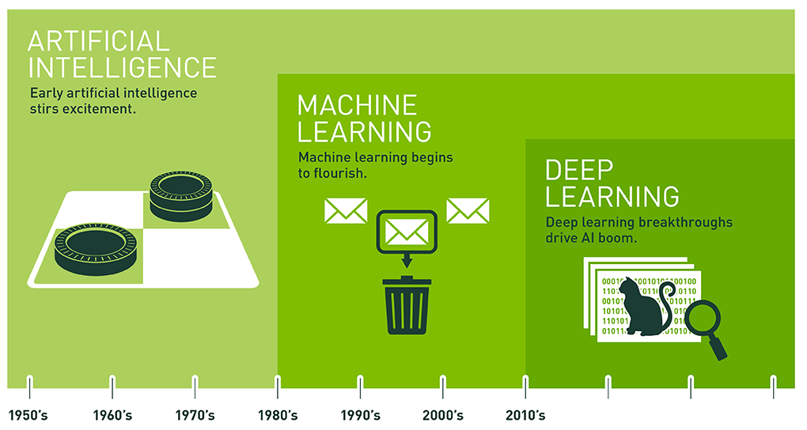
Deep Learning?
Source: Nvidia
Notes:
Background into Artificial Intelligence and Deep Learning
Artificial Intelligence as an academic discipline was founded in 1956 after a number of advances in the field with the first neural net machine developed, the SNARC, and the Turing Test. However, the broad definition of Artificial Intelligence covers any device that in some way can mimic cognitive function.
Machine Learning however came around the 1980s and are used to identify any algorithm that can take in data, learn from that data, and then apply what they have learned to make ‘better’ decisions. It was really reborn due to the rediscovery of back propagation with powerful hardware being more accessible. Which we will get to in a bit.
Deep Learning however is once again a subset of a greater field, this being machine learning, and is used to describe an algorithm that contains large artificial neural networks. The models are designed to continually analyse inputted data with a logic structure similar to how a human would draw conclusions. The term deep often refers to the layers involved within the neural net.
Deep Learning has really only surged in the 21st, once again due to our access to more and more powerful hardware. If you were at the DeepNeuron Futures Panel a while back, you’ll probably remember hearing Sanjay from KPMG share his story about how it took him weeks if not months to train a simple neural network, so our advancement in computing technology has really allowed a group like ours to excel.

Slide 5
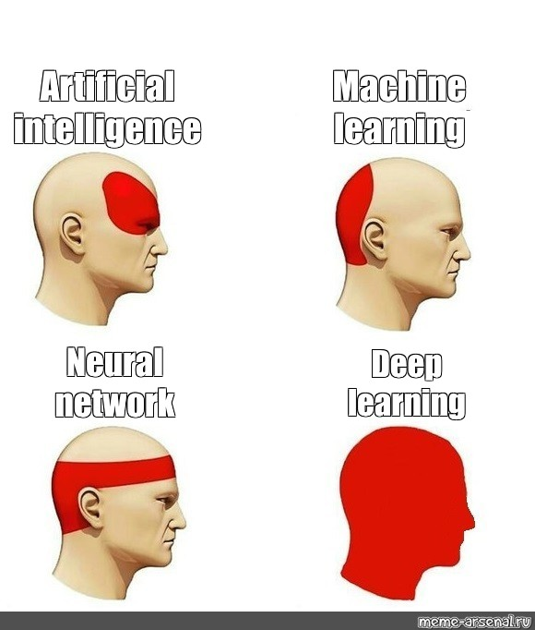
Deep Learning?
Source: meme-arsenalry
Notes:
Background into Artificial Intelligence and Deep Learning
Artificial Intelligence as an academic discipline was founded in 1956 after a number of advances in the field with the first neural net machine developed, the SNARC, and the Turing Test. However, the broad definition of Artificial Intelligence covers any device that in some way can mimic cognitive function.
Machine Learning however came around the 1980s and are used to identify any algorithm that can take in data, learn from that data, and then apply what they have learned to make ‘better’ decisions. It was really reborn due to the rediscovery of back propagation with powerful hardware being more accessible. Which we will get to in a bit.
Deep Learning however is once again a subset of a greater field, this being machine learning, and is used to describe an algorithm that contains large artificial neural networks. The models are designed to continually analyse inputted data with a logic structure similar to how a human would draw conclusions. The term deep often refers to the layers involved within the neural net.
Deep Learning has really only surged in the 21st, once again due to our access to more and more powerful hardware. If you were at the DeepNeuron Futures Panel a while back, you’ll probably remember hearing Sanjay from KPMG share his story about how it took him weeks if not months to train a simple neural network, so our advancement in computing technology has really allowed a group like ours to excel.

Slide 6
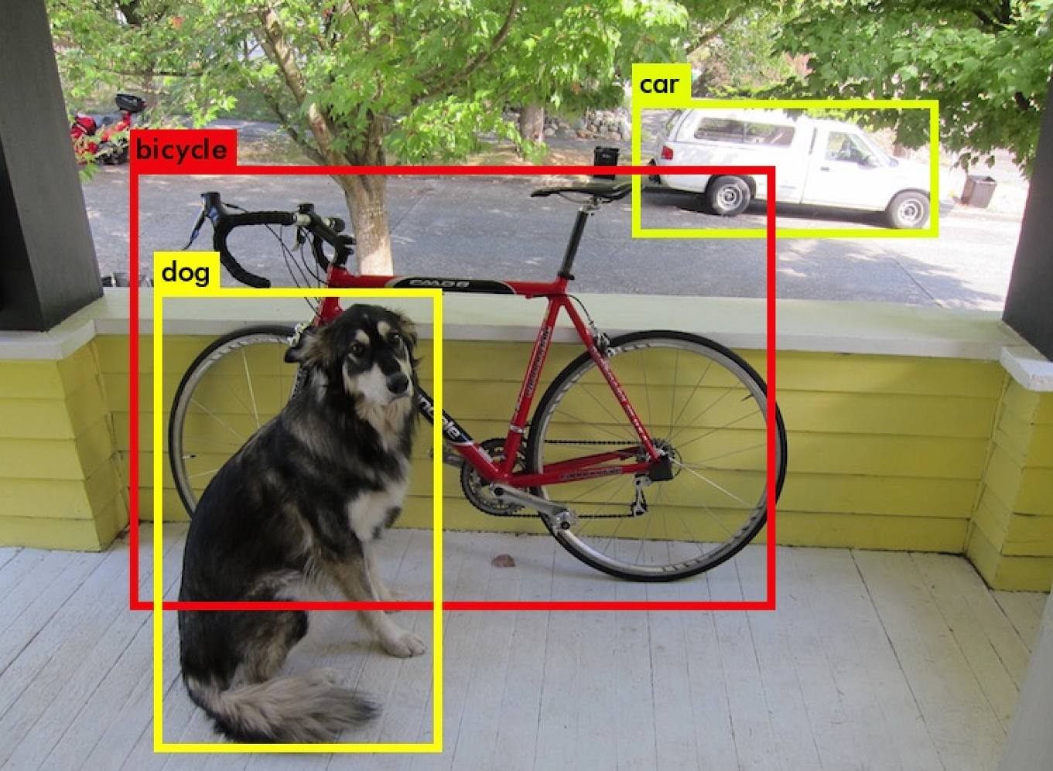
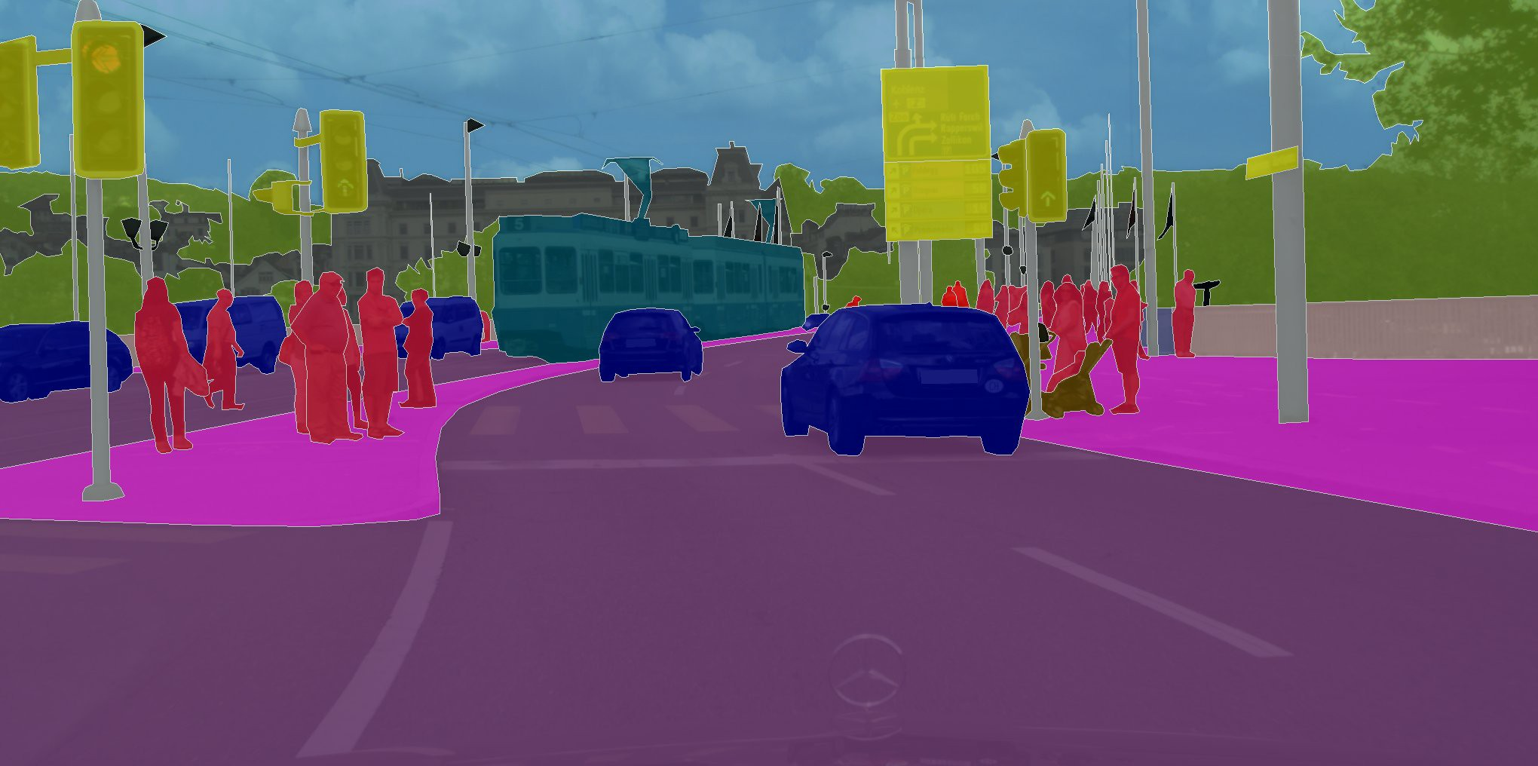
Deep Learning Applications
Source: YOLO and Udacity
Notes:
Just for some examples of where deep learning can be used, on the left with a camera that can identify different objects and animals that are in frame, and on the right we have an image from the Tesla automated Driving system which can identify in real-time where they are on the road with respect to their surroundings.

Slide 7
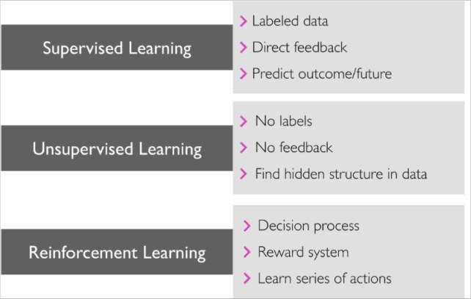
Different Types of Machine Learning
Source: kdnuggets.com
Notes:
Within Machine Learning we have three main areas, supervised learning, unsupervised learning, and reinforcement learning. Supervised Learning Algorithms are generally applied to datasets that a labelled. Meaning, for every image, there is a label, such as when you did a worksheet in school, there was always an answer to each question. Another way of thinking about this is similar to when a teacher is supervising a student on whether they’re doing a task correctly or not. Thanks to Intellipaat for that analogy.
So why would we use supervised learning?
We generally use supervised learning for a classification problem, or a regression problem. A classification problem generally involves the prediction of a discrete value from the input data. In today’s practical task we will be going through a classification problem, where we will use a model to take photos in from the dataset, and classify these images into a labeled category. A regression problem can be used for more continuous datasets, for example the estimation of cost given a set of variables could be used for the model to develop a suitable method of predicting the most accurate cost.
Unsupervised Learning and Reinforcement Learning aren’t touched on very much during this training series, however unsupervised learning is as it sounds, unsupervised, with no labels as opposed to supervised learning, and no feedback. The purpose of unsupervised learning is to generally find unknown or hidden patterns within the data.
Reinforcement learning is more the study of how the AI will make a decision and learn from these decisions to maximise it’s rewards within a given environment over time. We we won’t be touching on reinforcement learning during this training session but we do have a dedicated reinforcement learning team.

Slide 8
Deep Learning Concepts

Slide 9
Key Ingredients
Dataset
Model
Training
Evaluation
Training and validation set, augmentation
Architecture, transfer learning
Epochs, losses, overfitting, learning rate
Metrics, loss investigation
1
2
3
4
Notes:
In deep learning, we have four key ingredients that we will go over today, to building a successful model. These include
A varied dataset that has a large amount data for the model to learn from. Data is by far the most important factor, as for deep learning we need data, and lots of it, the larger the dataset, the better.
A model with an architecture suited to solving the required problem. We can either use a pre-trained model using transfer learning or create a network from architecture from scratch. For today’s task we will use an architecture known as ResNet-34 and we will go through transfer learning in more detail.
A well planned training cycle.
A good evaluation of the model to determine if further investigation is required
Let’s start with the dataset.

Slide 10
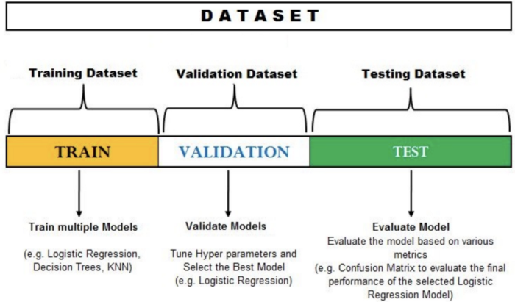
Dataset
Training vs Validation vs Testing for Datasets
1
Source: https://medium.com/@Ana_Caballero_H/
Notes:
So a dataset is essentially what it sounds like, a set of data. We usually start with the dataset when approaching a deep learning problem as we want to build our model to accurately predict similar data that will be passed through it. Generally, we split the given dataset into three areas.
Firstly, we have a training set, this is a set of example data that is used for the network to learn.
We have a validation set, which is used to tune the parameters of the network
And we have a test set, which is a set of data used only to assess the performance of a fully specified classifier.
So why can’t we just have one set of data to train, validate and test, well, if we train the data on the same set of validation, we won’t be able to tell whether the model has actually learned from the data or the model has learned the data. The distinction is key because the purpose of using deep learning is to be able to accurately make a prediction from a new data, given its previous training.
Usually the dataset is also put through a series of transformations, such as a modification of height and width/scale/color or resolution if the data is a set of images, or a process known as data augmentation which is a technique to artificially create new training data from existing. We are not going to explore these techniques today but they will be useful later on.

Slide 11
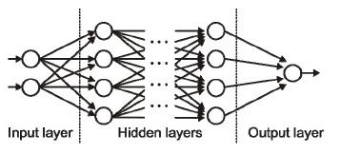
Model
What is a Neural Net?
2
Source: https://medium.com/@Ana_Caballero_H/
Notes:
This is the point we’ve been building up to, neural networks essentially form the backbone of deep learning, the aim is to essentially find an approximation of an unknown function. Neural nets are made up of many artificial neurons, known as perceptrons. The data is first passed through the input layer, the first layer of the network. The hidden layers take the outputs of the input layers to perform tasks on the data to sequentially pass the output in and out of the consecutive layers. Finally an output data is generated, which as we mentioned before, is an approximation of an unknown function. This movement of the data is known as forward propogation. The hidden layers are called “hidden” for a reason, as we cannot see the what is being processed in there, only the input and output layers are visible to us. Each

Slide 12
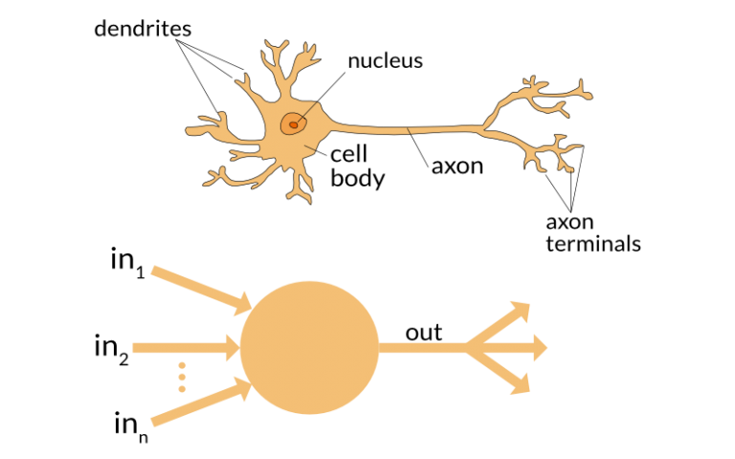
Model
What is a Perceptron?
2
Source: https://medium.com/@Ana_Caballero_H/
Notes:
So let’s dive a little deeper neural network theory and come back to what we have just mentioned. The building blocks of the neural network are perceptrons, essentially an artificial neuron that has been modelled as such. A perceptron has an input that takes in a form of information, or electrical signals, it processes it in the nucleus, and then generates an output which is can be either sent to other neurons for further processing, or it can be considered the final product or output.

Slide 13
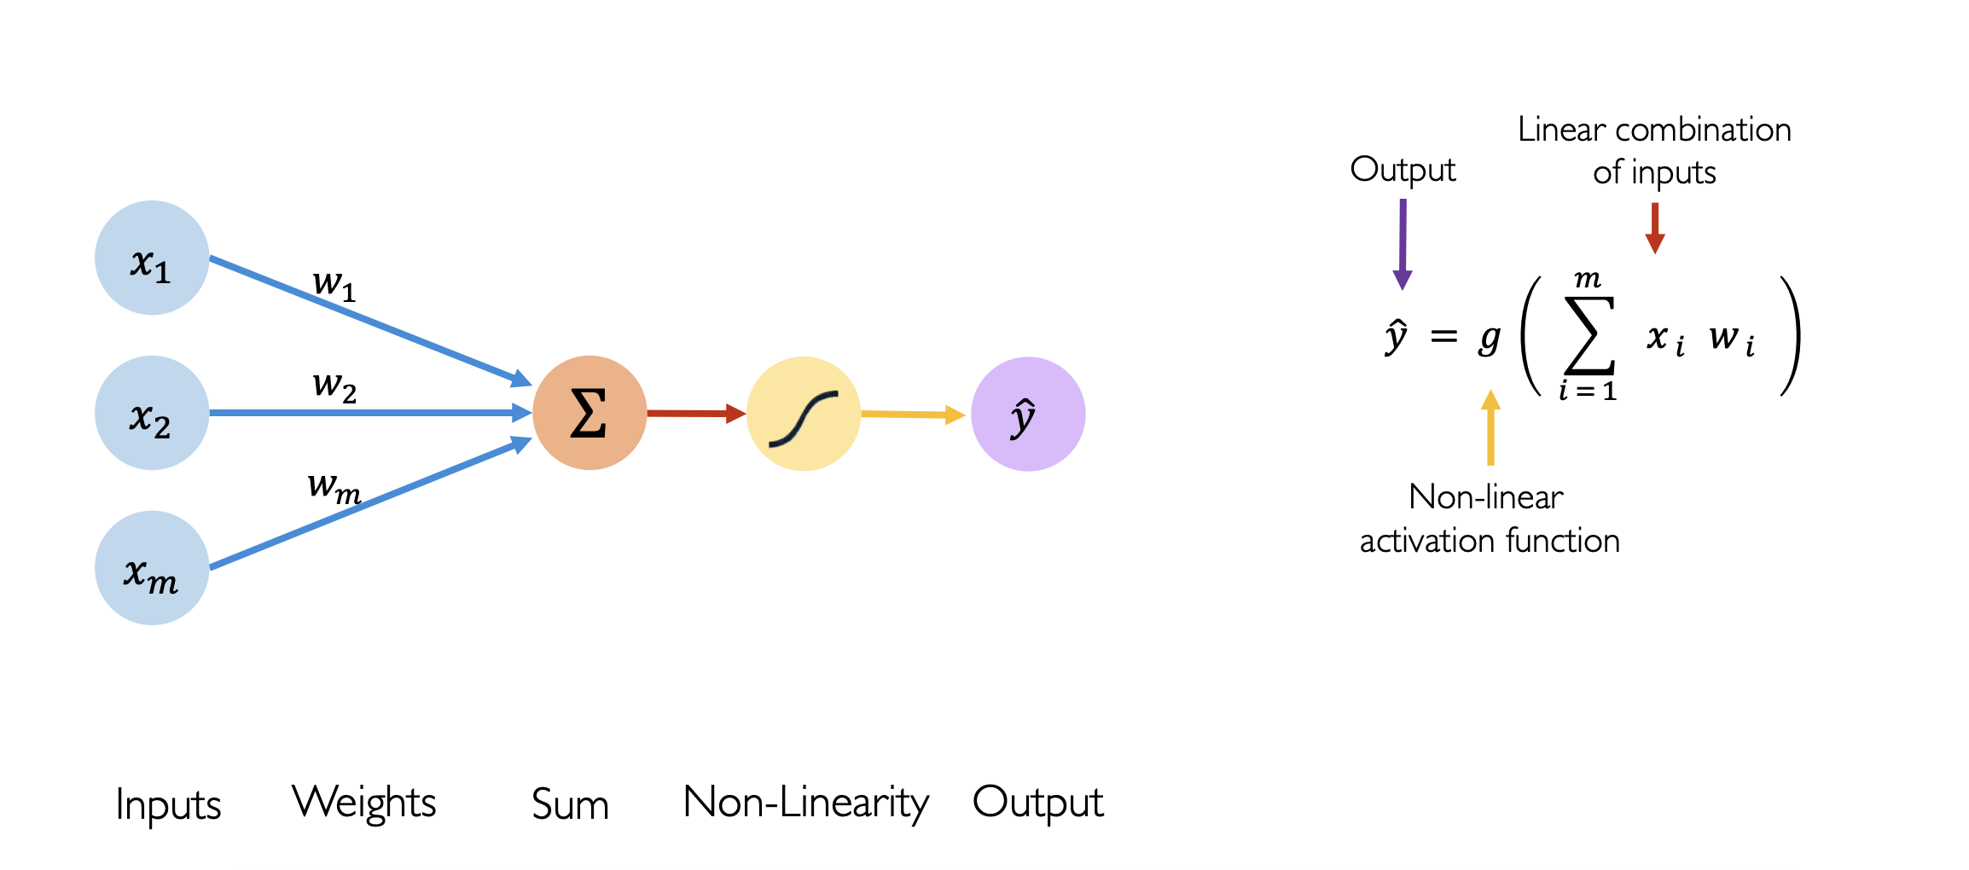
Model
What is a Perceptron?
2
Source: https://medium.com/@Ana_Caballero_H
Notes:
So if we breakdown a perceptron within our neural nets into different blocks, you can see that we have the input labelled by x, these inputs get multiplied by a weight. Each input has a corresponding weight assigned to it. When we initialise the network, weights are randomly assigned, and they are updated as the training process goes on. Over time, the neural network will assign a higher weight to the input it considers more important, and vice-versa. You then sum the products of each input with it’s respective weight. We then sum every input, weight pair and pass it through a non-linear activation function, which makes the network “deep”. The activation function translates the input signals to output signals. It prevents the network from collapsing into a single linear classifier, it allows each layer to build up on the results of the preceding non-linear layer which leads to a complex non-linear function that is able to approximate the unknown function. Essentially, it activation functions make the network work.

Slide 14
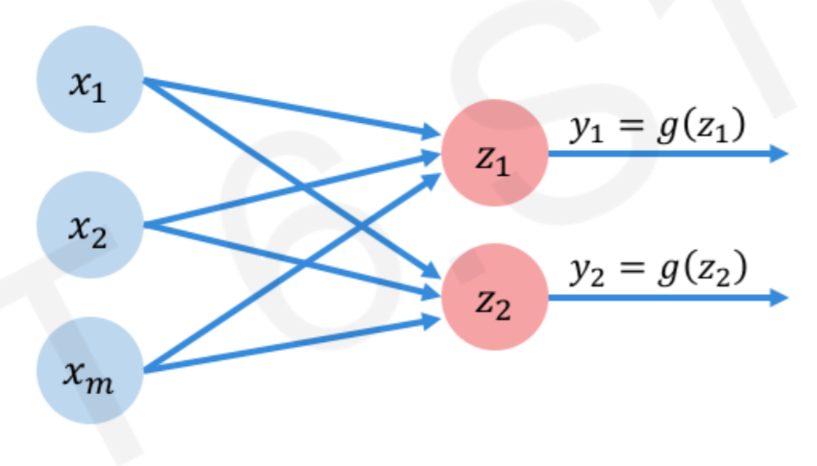
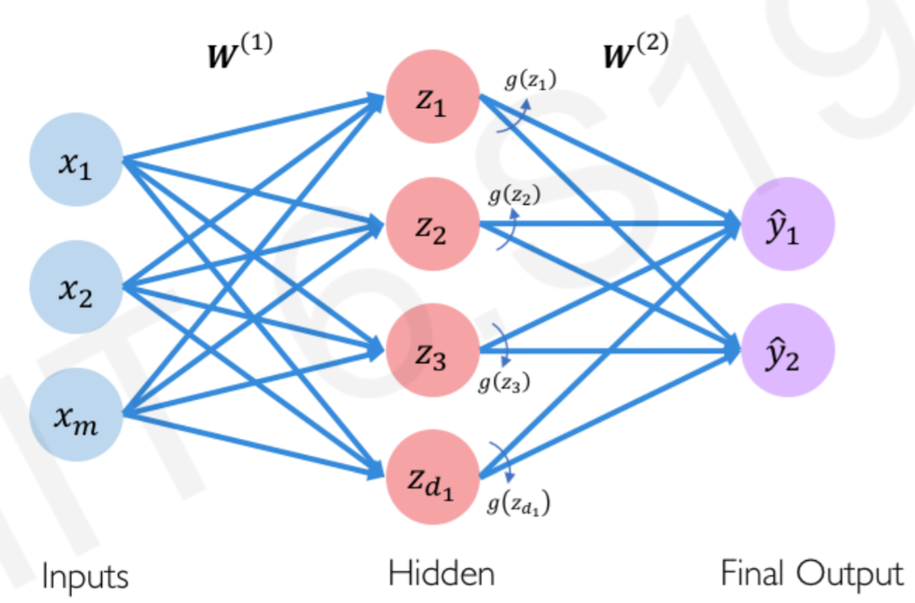
Building the Neural Net
Model
2
Single layer Neural Network
Multiple perceptrons creates a ‘Dense layer’
© MIT 6.S191: Introduction to Deep Learning
Notes:
So what begins to happen, is you can add multiple perceptrons to create what we call a dense layer, which we still take inputs, pass it through an activation function, and it produces and output. Once you start putting more and more together, you have a neural net. The hidden layers are how we classify the neural net, so here the network is a single layer network as there is one single hidden layer.

Slide 15
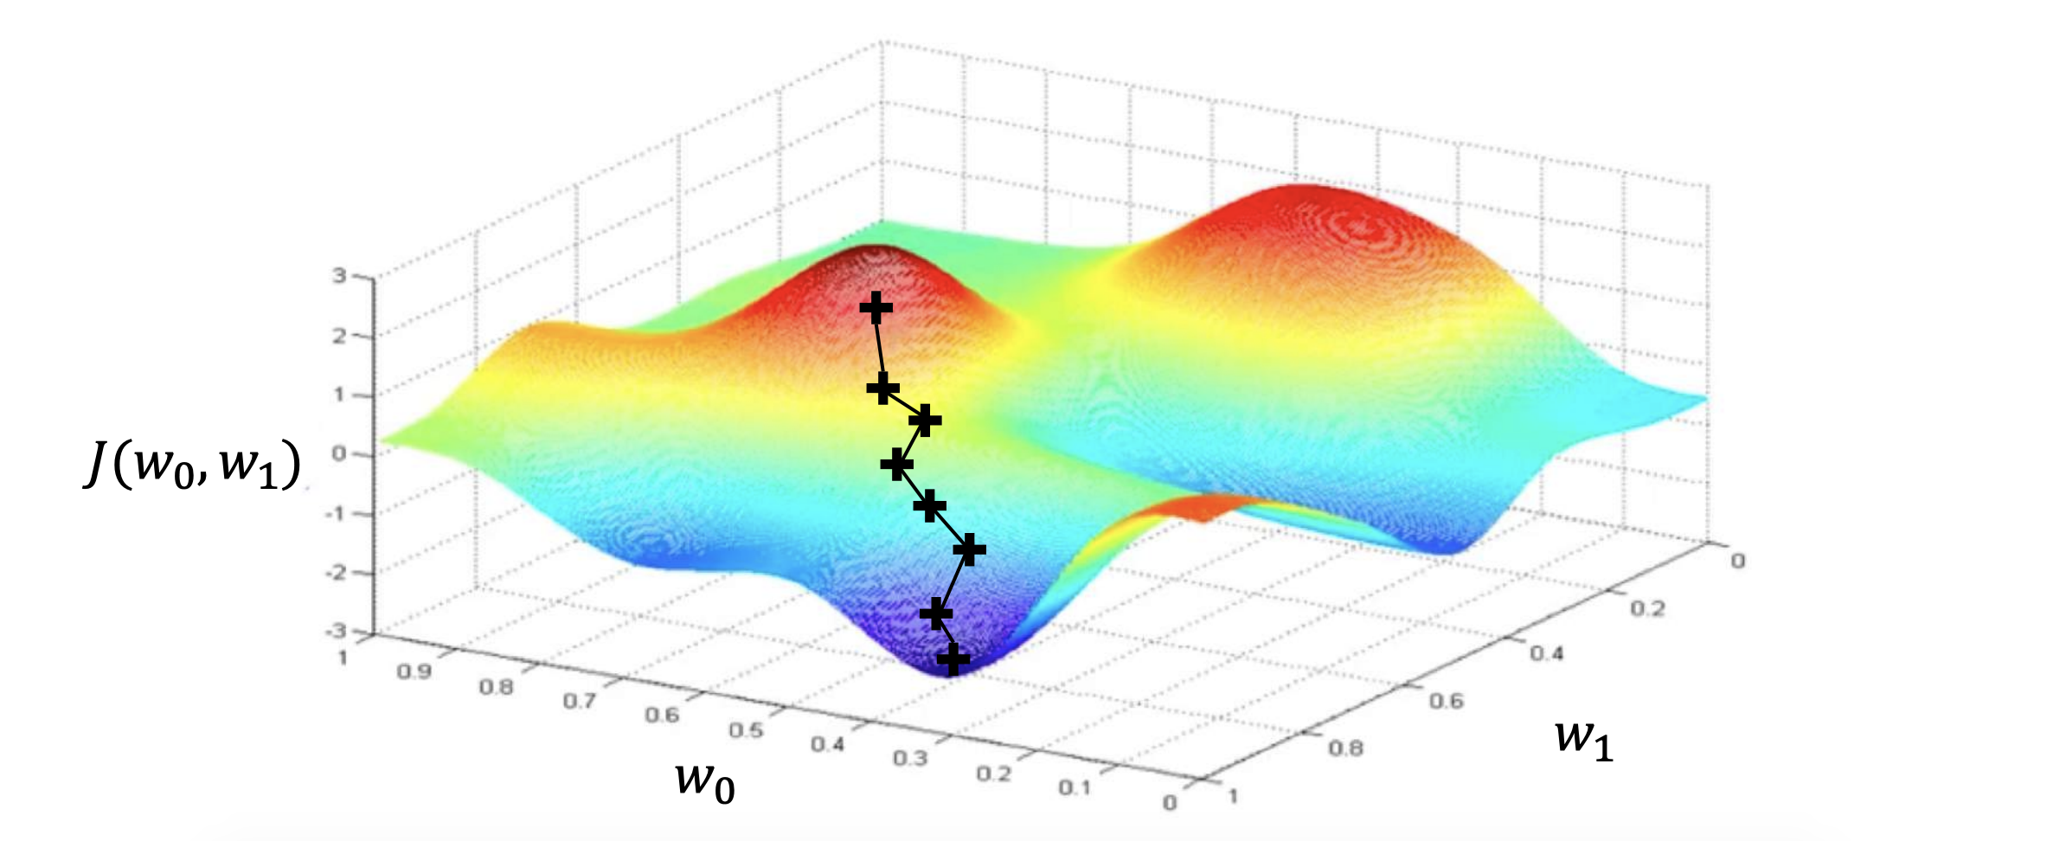
Loss Function
Model
2
Also known as cost or loss functions
Used to evaluate a candidate solution.
The function in which we aim to minimise in order to reduce the error in our model.
Notes:
Lets now move onto the objective function. Basically the objective function will measure the accuracy of our network, “quantifies how well our network is doing”. Essentially the loss function is a measure of the difference between the prediction and actual values, and will try and penalise the network when it makes error. As we train the network, our objective is to increase our prediction accuracy and reduce error, hence minimise the loss function is our aim during training.
This diagram is a very simple visualisation of what we call the “loss landscape”, as the loss is only a function of two weights, were in reality we could have 100s and it would not be able to be graphed accordingly. Our aim however can be well visualised here, we want to find point of global minima, so that our model is as accurate as possible.

Slide 16
How can we optimise this loss function?
Training
3
Common Optimisation Methods:
Gradient Descent
Stochastic Gradient Descent
Adaptive Learning Rate Method
Conjugate Gradient Method
Derivative - Free Optimisation
Zeroth Order Optimisation
Notes:
There are numerous common optimisation methods
Today we are looking into Gradient Descent

Slide 17
Gradient Descent
Training
3
Backpropagation used to calculate gradient based on inputs and output (each + sign is a gradient calculation)
Gradient, or steepness is assessed: very steep (large gradient) means lots of adjustment required.
Model adjusts the weights to move in the direction of the steepest gradient
© MIT 6.S191: Introduction to Deep Learning
Notes:
So once we have the neural network and we begin training, we can perform gradient descent to minimise the loss. AnalyticsVidhya had a nice analogy which illustrated how you could compare it to climbing down a hill, you should take small steps and walk down instead of just jumping down all at once. If we start from a certain point, and we moved down a little, we can keep going until we reach the very bottom. The amount we step down the mountain at any one point, is known as the learning rate. The amount you choose to go down at once though is very complex and problem specific, and generally it is way too complicated to determine this value, however as i will go through later, there is a method to choose a reasonable starting point.
To go back to gradient descent, the plus symbols on here is the model learning from the weights it currently has, so if you have two points and calculate the gradient, if it is positive, you know that you have traversed up the landscape, which is bad, vice-versa, if the gradient is negative, we are going down the mountain, ie down the landscape. These gradients of the loss function can be used to update the weights of the model, this process is known as backpropogation. The movement of the network however is backwards, the error along with the gradient flows back from the output layer, through the hidden layers and the weights are updated.

Slide 18
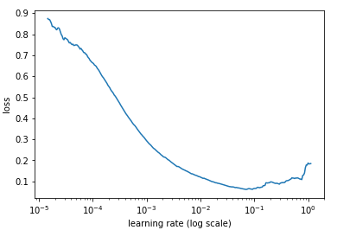
Learning Rate
Training
3
The size of the step we travers the loss landscape
Source: towardsdatascience.com
Notes:
The rate at which we descend towards the minima of the cost function

Slide 19
Epochs
Evaluation
4
A single iteration of training for the entire dataset.
1 Epoch indicates a single forward and backward pass of the entire input data.
Notes:
So we move onto evaluation, epochs are defined as a single training iteration, for a bit of explanation, one epoch means an entire forward pass and backward pass of all the input data. Generally the number of epochs you choose to train with impacts how accurate the network is, and how fit the model is to the data.

Slide 20
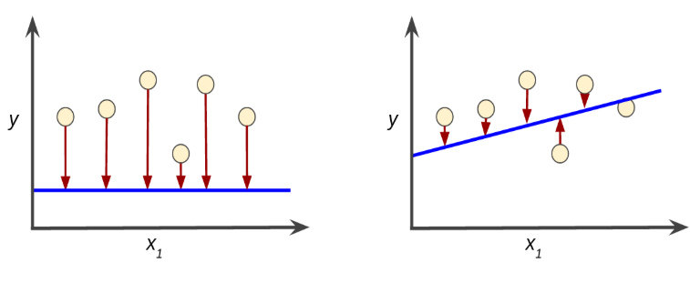
Loss Functions
Evaluation
4
Training loss and validation loss
Source: https://intellipaat.com/community/368/how-to-interpret-loss-and-accuracy-for-a-machine-learning-model
Notes:
Generally speaking, in fastai you will notice a training loss and validation loss, the training loss is the loss experienced through training, and the validation loss is the loss experienced when evaluating the model from the validation set, generally speaking, the validation loss converging is a good indicator that your model is also converging to it’s optimal performance.

Slide 21
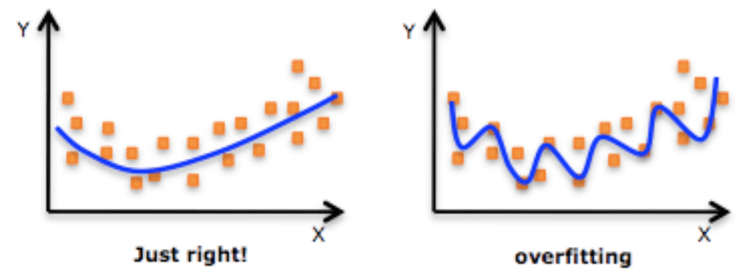
Overfitting
Evaluation
4
Occurs when the model is too closely fitted to the data
Source: https://intellipaat.com/community/368/how-to-interpret-loss-and-accuracy-for-a-machine-learning-model
Notes:
When the accuracy of our model becomes really high on our dataset, and we find that on another similar dataset our model seems to be much less accurate, we can conclude that our modelled has become overfitted to the training dataset, as the model has learned patterns to the specific set of data. Overfitting is a modelling error that can occur in statistics when a function is too closely fitted to a set of data, as can be seen in the images below. Here we can see that a function has been fit to the data points on the left to accurately model the data, whereas the function on the right has adapted to almost every single point/idiosyncrasy within the data.
In deep learning, our models tend to overfit when they have been over-trained on the training set. The deep learning practitioner must recognise when a minimum of loss is occurring and aim to stop training before the data becomes overfit to the model. Overfitting can also be reduced by training the network on more examples, and by also changing the complexity of the neural network architecture.

Slide 22
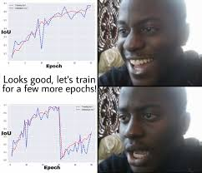
Overfitting
Evaluation
4
A meme at shocking resolution.
Source: https://intellipaat.com/community/368/how-to-interpret-loss-and-accuracy-for-a-machine-learning-model
Notes:
When the accuracy of our model becomes really high on our dataset, and we find that on another similar dataset our model seems to be much less accurate, we can conclude that our modelled has become overfitted to the training dataset, as the model has learned patterns to the specific set of data. Overfitting is a modelling error that can occur in statistics when a function is too closely fitted to a set of data, as can be seen in the images below. Here we can see that a function has been fit to the data points on the left to accurately model the data, whereas the function on the right has adapted to almost every single point/idiosyncrasy within the data.
In deep learning, our models tend to overfit when they have been over-trained on the training set. The deep learning practitioner must recognise when a minimum of loss is occurring and aim to stop training before the data becomes overfit to the model. Overfitting can also be reduced by training the network on more examples, and by also changing the complexity of the neural network architecture.

Slide 23
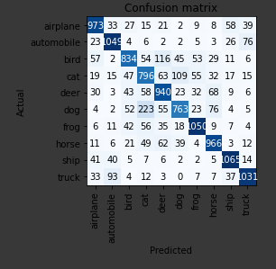
Metrics and Visualising Error
Evaluation
4
Seeing where the model went wrong is very important
Usually, we can identify problems with the dataset such as incorrect labels or low quality data
Two methods for visualising error include the confusion matrix and the top losses function in FastAI
Source: towardsdatascience.com

Slide 24
Breakout Room:
Discussion Time for 10 minutes
Notes:
What is a Perceptron?
Why can’t we only have one dataset for training, validation, and testing?

Slide 25
Breakout Time - 10 mins
Things you might want to ask about:
What prevents us from using a single dataset?
What happens with extremely small & large learning rates?
How can you combat over/under fitting?
Is climbing down a mountain a good analogy for gradient descent?
When should you stop training?

Slide 26
How do we do Deep Learning?

Slide 27


FastAI vs PyTorch
Arguably the easiest deep learning framework
Where possible FastAI makes the choices for us
Can be quick to create basic models
FastAI runs on top of PyTorch
PyTorch is an open source deep learning platform that provides a seamless path from research prototyping to production deployment
Flexible
Notes:
Well, now to get to the exciting part where we can actually use deep learning. So for today we will be using FastAI, which is a python library that we will use in today’s workshop. FastAI is arguably the easiest deep learning framework around, it’s a really great resource to get people interested as you could complete a classification problem within only five lines of code. FastAI is able to take some of the heavy-lifting away from people getting started, however we’ve sprinkled in some concepts that we have learnt about today to reinforce these ideas and start to build your intuition regarding deep learning.
Generally within Deep Neuron we’re not trying to reinvent the wheel every time we seek to use deep learning, we want to build upon the knowledge of others by taking an almost complete model and finely tune it towards the end to fit it to our problem.
FastAI is built upon PyTorch, which is an open source deep learning libray/framework which we will get into in later workshops.

Slide 28

Google Colaboratory
Colaboratory is a free Jupyter notebook environment that requires no setup and runs entirely in the cloud.
With Colaboratory you can write and execute code, save and share your analyses, and access powerful computing resources, all for free from your browser.
To open the training notebook, navigate to DeepNeuron Team Google Drive > Training > Week1_fastai_basics.ipynb. Right click and “Open with Google Colab”
MAKE A COPY
WARNING
Notes:
Open Google Colab and the Image Classification Training notebook

Slide 29
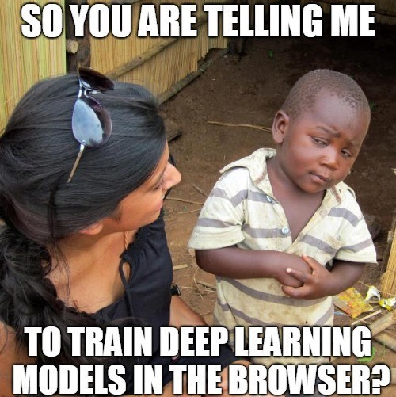
Google Colaboratory
Notes:
Open Google Colab and the Image Classification Training notebook

Slide 30
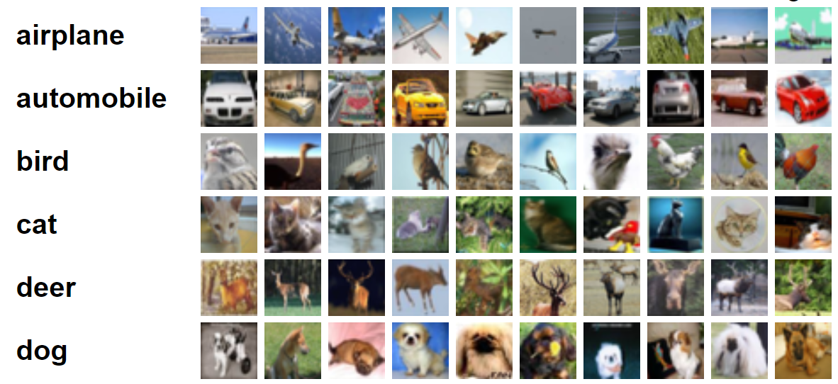
Practical Task
Image Classification with CIFAR10
Predict which class a distant, pixelated image belongs to.
Source: becominghuman.ai
Notes:
Today we’re gonna do an image classification task with Fast AI, using the CIFAR-10 dataset, which is a dataset of 60,000 images.
Work with the dataset, work with the model, work with training, work with evaluation.
I’ll quickly show you the workbook and how to get started.
Everyone will get a chance to give it a crack.

Slide 31
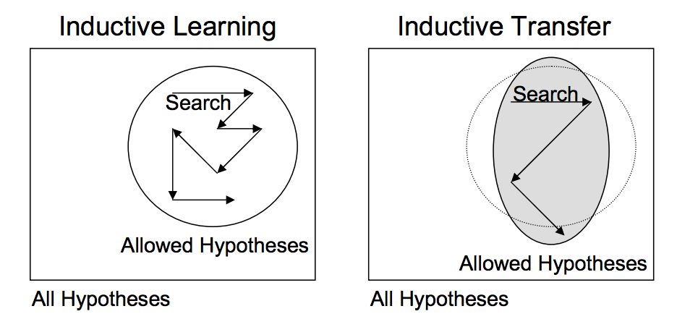
Transfer Learning
Source: A Gentle Introduction to Transfer Learning with Deep Learning
Notes:
Essentially, this form of transfer learning that we use is known as inductive transfer. This is where the scope of possible models is narrowed in a beneficial way by using a model fit on a different but related task.
This allows us to reuse a model that has been pretrained as a starting point for our model, saving both time and compute power. It also does not require us to develop the network architecture that might end up being worse then the pretrained model anyway.

Slide 32
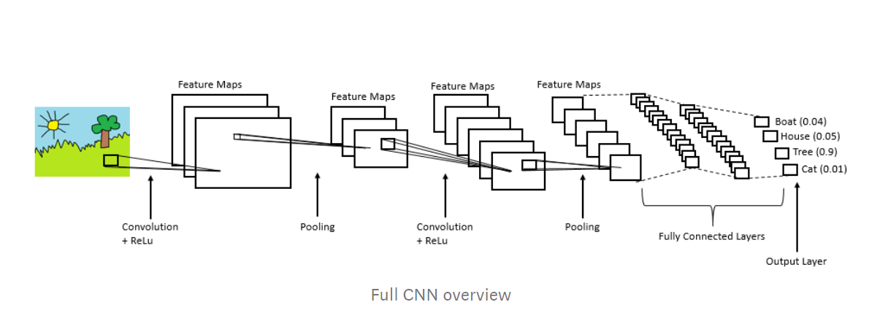
Practical Task
Utilise transfer learning with a CNN known as a ResNet-34 model as a base to train off of for our CIFAR dataset. The ResNet-34
Source: becominghuman.ai
Notes:
We’re not going to explain CNN’s in this workshop as Will is going to dive into them in the third workshop, however we will utilise them today for the image classification problem to show how neural nets can be used in prediction problems. The model we will be using is known as a Resnet model, specifically ResNet-34.
Today you will be able to work with the dataset, work with the model, work with training, work with evaluation.
Everyone will get a chance to give it a crack.

Slide 33
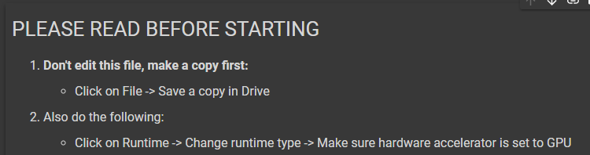
Practical Task
Once again remember:
Source: becominghuman.ai
Notes:
Please make sure you save a copy locally first, and also change the runtime type.

Slide 34
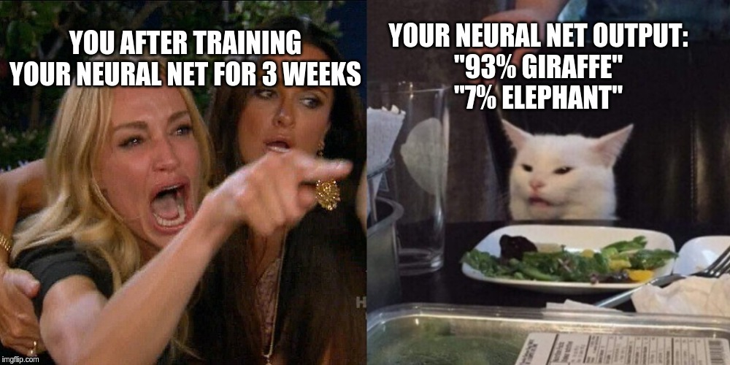
Practical Task
It will take time, and if you stuff up, your model may be terrible
Notes:
Please make sure you save a copy locally first, and also change the runtime type.

Slide 35
Breakout Room: Practical Task

Slide 36
Learning Rate
Training
3
The size of the step we traverse the loss landscape
Source: towardsdatascience.com
Notes:
So the point of that last evaluation activity with regards to the learning rate was for everyone to get an intuitive understanding of how learning rate can impact the accuracy. The answer to what is the optimal learning rate, well it is still incredibly complex and problem dependent, but generally speaking, a good estimate for a starting learning rate can come from the point at which the greatest change in loss occurs on the descent to the minima. What i mean by this is that the learning rate at the steepest point of descent on the graph, is generally a great starting point as it is the point where the loss is improving the fastest.

Slide 37
Thank you for listening!

